Slide 1
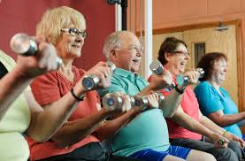
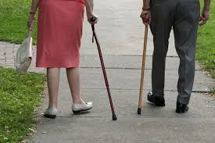
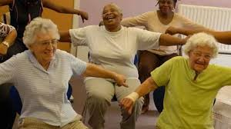
Launch Event
PHR Project:13/164/51
REACT: Retirement in ACTion Dr Afroditi Stathi A.Stathi@bath.ac.uk
3rd December 2015
Notes:
I would like to welcome you to the Launch of the RETIREMENT IN ACTION STUDY. THE REACT IDEA WAS PLANTED SIX YEARS DURING THE WORKSHOPS OF THE AVONETWORK. IT WAS IN A MULTIDISCIPLINARY MEETING LIKE THIS THAT WE ALL AGREED THAT TARGETING OLDER PEOPLE WITH MOBILITY LIMITATIONS WAS AN IMPORTANT AREA FOR PHYSICAL ACTIVITY PROMOTION. AND WE WERE RIGHT! IT JUST TOOK US A BIT OF TIME TO CONVINCE THE FUNDING BODIES TO SUPPORT US FINANCIALLY. BUT WE MADE IT AND TODAY WE CELEBRATE THAT WE HAVE THE OPPORTUNITY TO TEST A PROGRAMME WHICH WE STRONGLY BELIEVE THAT CAN MAKE A DIFFERENCE IN OLDER PEOPLE’S LIVES.

Slide 2
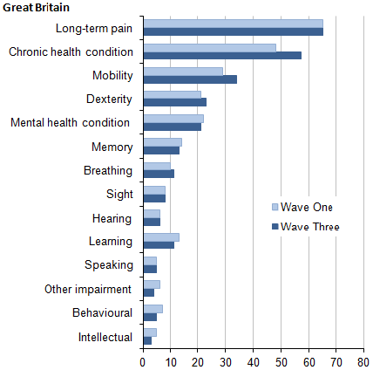
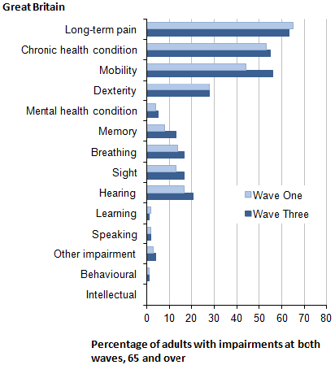
REACT: The public health challenge
Adults 16-64
Adults 65+
Sedentary and low activity habits
Decline in physical and cognitive function
Increasing isolation and loss of independence
Premature death / poor quality of life / huge health and social care bills
Accelerated biological aging / chronic disease
ONS Life Opportunities Survey, 2015
HSE, 2014

Slide 3
Research Question
What is the effectiveness and cost-effectiveness of a community-based physical activity intervention for reducing the progression of functional limitations in older people who are at high risk of mobility-related disability?

Slide 4
REACT: Management Team
University of Bath
Dr Afroditi Stathi (Chief Investigator)
Dr Janet Withall (Trial Manager)
Dr James Bilzon
Dr Gordon Taylor
Dr Sean Williams
Jolanthe de Koning (Research Assistant)
Max Western (Research Assistant)
Rachel Chapman (Project Coordinator)
University of Exeter
Professor Colin Greaves
Professor Colin Green
Dr Antonieta Medina-Lara
Jessica Bollen (Research Assistant)
University of Oxford
Professor Heidi Johansen-Berg
University of West of England
Professor Selena Gray
University of Birmingham
Professor Janice Thompson
Sarah Coleman (Research Assistant)
University of Bristol
Emeritus Professor Ken Fox

Slide 5
Steering and Monitoring Committees
Trial Steering Committee
Chair | Professor Yoav Ben Schlomo, University of Bristol
Members | Dr Kate Walters, University College London Professor Peter Thomas, University of Bournemouth Professor Diane Crone, University of Gloucester Dr Paul Bennet, General Practitioner David Goodman, Research Partner Jameelah Ingram, Bath and North East Somerset Council Dr Afroditi Stathi, University of Bath (Chief Investigator) Dr Janet Withall, University of Bath (Trial Manager)
Data Monitoring and Ethics Committee
Chair | Professor Dawn Skelton, Glasgow Caledonian University
Members | Professor Paul Ewings, National Institute of Health Research Professor Peter Thomas, University of Bournemouth Professor Kamlesh Khunti, University of Leicester

Slide 6
Community Partners, Research Partners and Advisory group
Community Partners
Members | Bath and North East Somerset Council AGE UK Birmingham Westbank Charity, Exeter St Monica’s Trust St John’s Hospital GLL Sirona Brunelcare
Research Partners and Advisory group
Members | David Goodman, Research Partner Roger Greenhalgh, Research partner Pat Thyer, Research Partner Marion Burfield, Advisory group Sonia Delauney, Advisory group Kenice Fisher, Advisory group Bernice Robbins, Advisory group Brian Higgins, Advisory group

Slide 7
REACT Community partners
Bath Partners
Members | Dr Kate Walters, University College London Professor Peter Thomas, University of Bournemouth Professor Diane Crone, University of Gloucester David Goodman, Research Partner Jameelah Ingram, Bath and North East Somerset Council Dr Afroditi Stathi, University of Bath (Chief Investigator) Dr Janet Withall, University of Bath (Trial Manager)

Slide 8
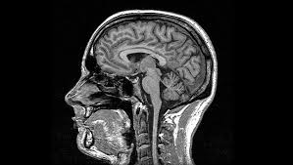
REACT: The Project
REACT includes:
A full economic evaluation
Process evaluation
fMRI imaging sub-study to detect brain changes
Based on the successful US trial
A multi-centre, pragmatic RCT
To examine the long-term effect (24 months) of exercise intervention on:
Mobility-related disability
Levels of physical activity
Quality of life and well-being
Ability to perform activities of daily living
Aim: physical activity intervention to preserve ability to walk in 1600 older adults

Slide 9
REACT: Study design
Week
0
Week 26
Week 52
Week 104
Participants invited to take part
Telephone Screen
Consent and face-face screening
Assessment 1
BASELINE
Eligible participants Randomised into intervention or control group
Assessment 2
MID-INTERVENTION
Assessment 3
POST-INTERVENTION
Assessment 4
Follow-up
Recruitment and Screening
Active intervention – 12 Months
Follow-up – 12 Months
Primary outcome at assessments
progression of mobility-related functional limitations – SPPB
Secondary outcomes:
moderate intensity physical activity
health-related quality of life
cognitive function
ability to perform the activities of daily living
mental and social well-being
fatigue
pain
improved sleep quality
Plus a full economic evaluation

Slide 10
REACT: Outcomes
Primary outcome
Functional ability (independently assessed performance on a sit-to-stand task, a standing balance test and gait speed), measured using the Short Physical Performance Battery (SPPB) at 24 months.
Secondary outcomes:
moderate intensity physical activity
health-related quality of life
cognitive function
ability to perform activities of daily living
mental and social well-being
fatigue
pain
Sleep quality

Slide 11
REACT: Recruitment
768 participants from Bristol/Bath, Birmingham and Devon
People at risk of major mobility-related limitations
Poor physical function
(SPPB of 8 or less)
Retired (65+)
Focus on areas of higher deprivation
Focus on ethnic minorities
Recruitment will be via primary care and third sector organisations

Slide 12
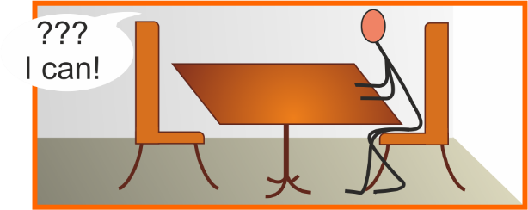
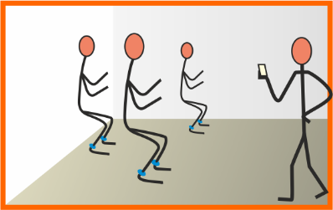
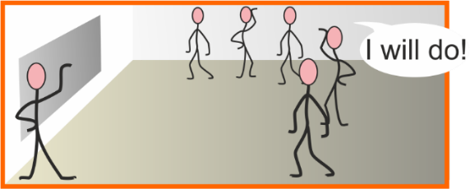
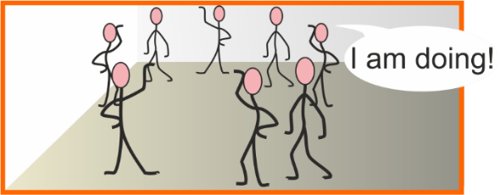
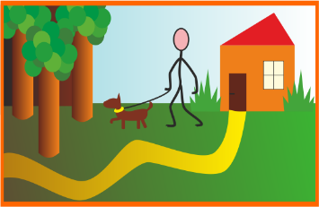
REACT: Structure of intervention
Adoption 1
Adoption 2
Maintenance
weekly 45 minute educational and social sessions
2x 60 minute group exercise
Cardiovascular
Strength
Coordination
Flexibility
Ambassador Programme
Become researcher
Support other REACTors
Support partner initiatives
Down to 1x 60 minute group activity session
1 - 1 starter session
45 min
Monthly group meetings
Week 1
Week 9
Week 25
Week 52
Notes:
Adoption 1 (weeks 1-8)
Emphasis on getting started, planning, reducing anxiety and building confidence and attachment to the programme
45 minute face to face individual induction session
2 x 60 minute activity sessions per week
12 month exercise/social programme delivered in a variety of facilities
1 x 45 minute one-to-one starter session
60 minute exercise sessions in groups of about 15 people
45 minute educational/social session
Focus on socialising opportunities and enjoyment
Includes support to engage with local activities to sustain long term impact
Groups sessions (15-20 per group)
Targeting cardiovascular capacity, strength, co-ordination and flexibility
Twice weekly during adoption phase (weeks 1-12)
Once a week during maintenance phase (weeks 13-52)
Strong focus on socialising opportunities and enjoyment
Actively supporting participants to engage with local activities to sustain long term impact
The sessions could continue to be delivered by our partners after the end of the 12 months
Adoption 2 (weeks 9-24)
Emphasis on developing exercise knowledge and behavioural skills and building home and community-based activity
1 x 60 minute activity session per week (from week 13 on)
1 x 45 minute educational and social session throughout (15 of them)
Maintenance (weeks 25-52)
Emphasis on building independence and community/home-based activity programme
1 x 60 minute activity session (optional) (groups may be merged)
1 group meeting per month (6 in total) to support action plans and build out of session activity
Opportunity to join Ambassador programme
Ambassador programme for REACT participants
Participants become active researchers and/or promoters of local initiatives for older adults
Support REACT in maintenance stage
Support partner organisations with initiatives targeting older people

Slide 13
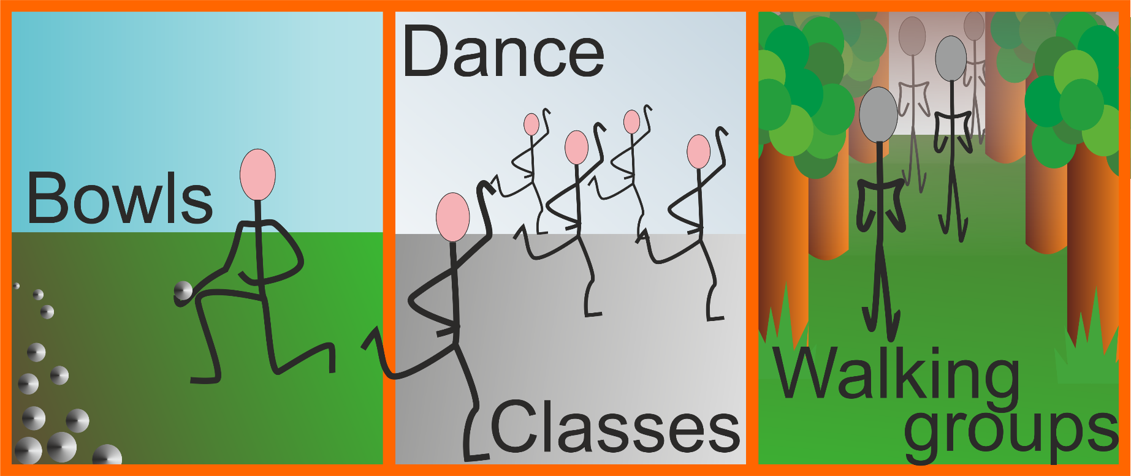
REACT: Structure of intervention
Maintenance
Week 25
Week 52

Slide 14
REACT: Progress so far
HRA Ethics Application submitted and approved
Appointment of 4 research assistants
4 Trial Management group meetings
1 Trial Steering Committee meetings
1 Advisory Group meeting
Clinical Research Network Application
Meetings with community partners – Preparation for intervention delivery
Identification of GP practices for recruitment

Slide 15
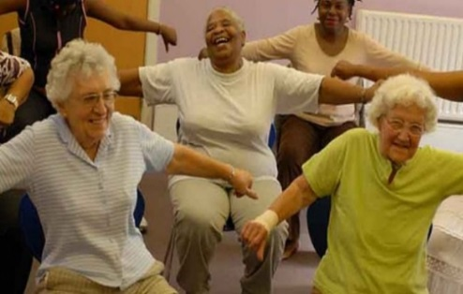
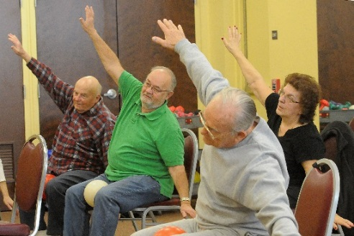
REACT: Launch event focus
So why are we here today
To update you on REACT progress
To meet our community and academic partners and give you a chance to meet each other
To pick your brains and get your input to REACT ….. because the sum is greater than all the parts
Notes:
Parts

Slide 16
REACT: Launch event agenda
10am | Welcome, introduction to the team and overview of REACT | Dr Afroditi Stathi University of Bath
10.45am | The LIFE Study: Rationale, Design and Results | Professor Jack Guralnik University of Maryland, USA
11.15am | Question and Answer Session
11.30am | The LIFE Study: An Inside Look at the Physical Activity Intervention | Dr Jack Rejeski University of Maryland, USA
12.00 | Question and Answer Session
12.15pm | Workshop a) Refining the REACT recruitment plan Workshop b) REACT Education sessions | All
12.45pm | Session feedback | Dr Janet Withall
 | LUNCH 1pm – 2pm
2pm | Introduction to the co-creation workshops** | Dr Afroditi Stathi
 | Workshop a) Retaining the REACT control group Workshop b) Retaining the Intervention group Workshop c) Socialising and Group Cohesion Workshop d) Terminology, Transport and anything else we should be worried about …. | All
3.10pm | Workshop feedback | Dr Janet Withall
3.30pm | Wrap up and next steps | Dr Afroditi Stathi

Slide 17
Without the funding from the NIHR public health unit, REACT would not be possible.

Slide 18
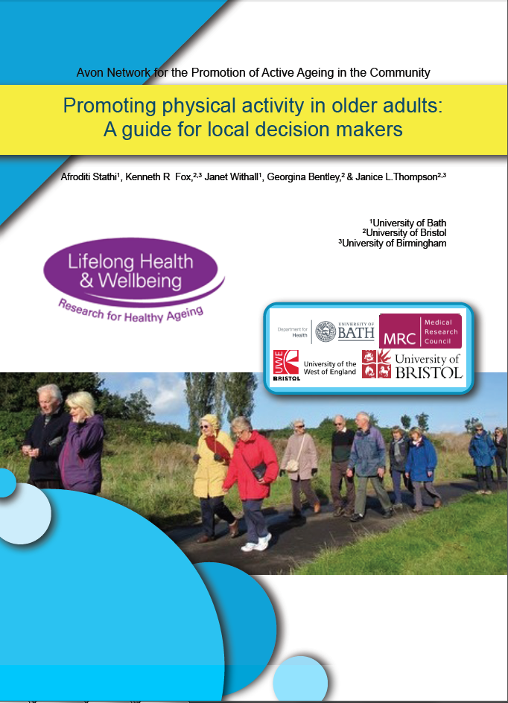
Service users-public involvement
REACT builds on AVONetwork for promoting active ageing in the community (MRC-LLHW 2)
http://ageactionalliance.org/wordpress/wp-content/uploads/2014/03/AVONet-report-2014-March.pdf
Research Partners on:
Trial Management Group
Trial Steering Committee
Advisory groups
Input to project documents
Assessing/testing measurement pack

